Slide 1
ANALYTICAL CRM DEVELOPMENT FOR A BANK
BY PAVITHRA M

Slide 2
INTRODUCTION
The file consists of 7 excel files. Out of 7 only 2 files contains Bank churn details and customer information.
5 files contains only categorical values.
The Customer info and bank churn file consists of details of 10000 customers, Geography, Gender, Date of Joining the Bank , Tenure ,Credit Card Status, Number of Products, Balance, Estimated Salary and Exit Status
The Categorical value files can be merged with the main files of Customer Information and Bank Churn

Slide 3
Tools required
Microsoft Excel
Microsoft Power Bi
My SQL workbench
Microsoft Word

Slide 4
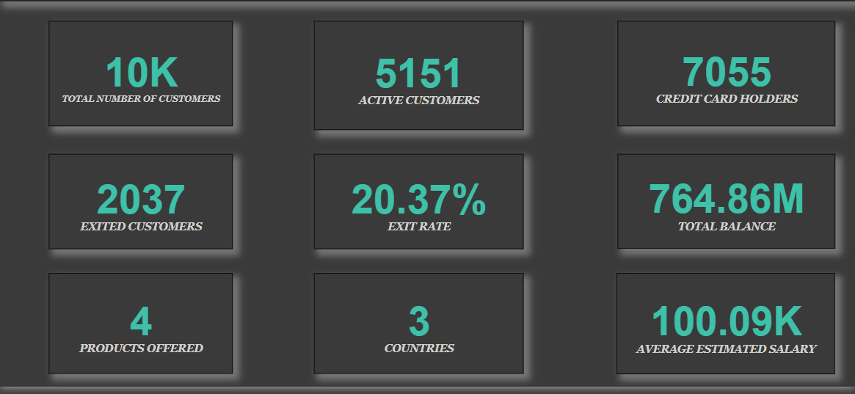
overview

Slide 5
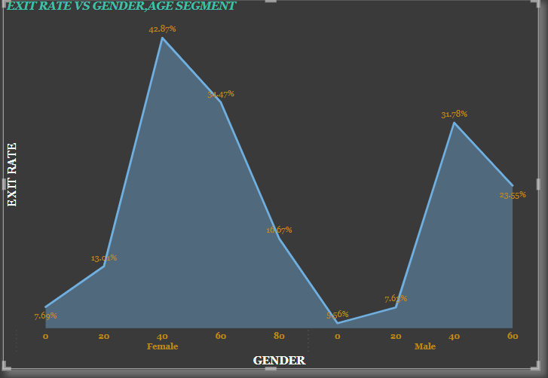
Gender, AGE SEGMENT vs churn rate
The age segment of the customer is divided into 5 segments to analyse the churn rate.
The 40-60 age segment is having the highest churn rate of 37.08 followed by 28.57%.
The minor and senior citizen group customers are having the lowest churn rate of 6.12% and 6.67% respectively.
Females are having higher churn rate when compared to males.

Slide 6
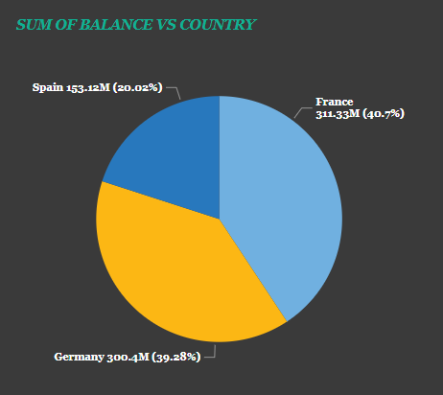
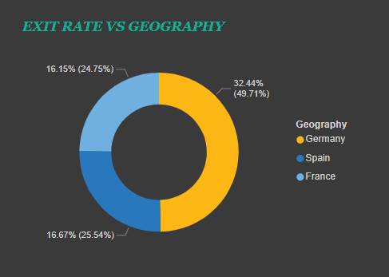
Geography analysis
Out of 3 countries, Customers of France is having highest balance and spain being the lowest .
The exit rate analysis shows that Germany is having highest churn rate compared to France and Spain

Slide 7
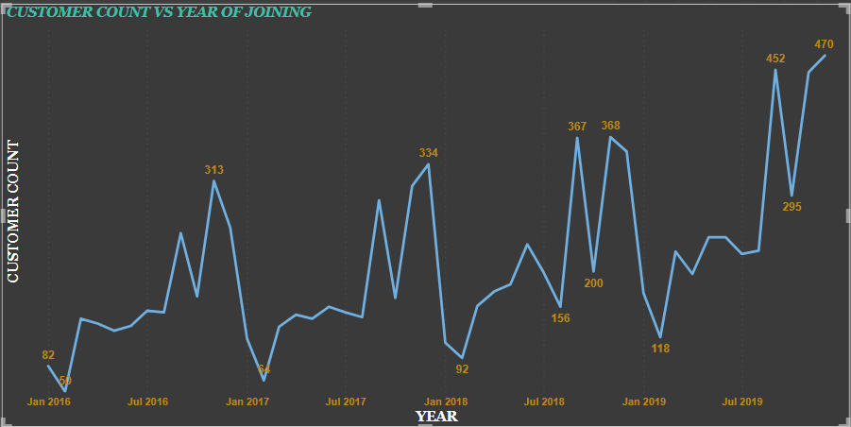
CUSTOMER COUNT VS DATE OF JOINING
The trend of customer joining is explained above in a line graph. It says the number of customers joined the bank is high in July 2019 and Jan 2017 being the lowest

Slide 8
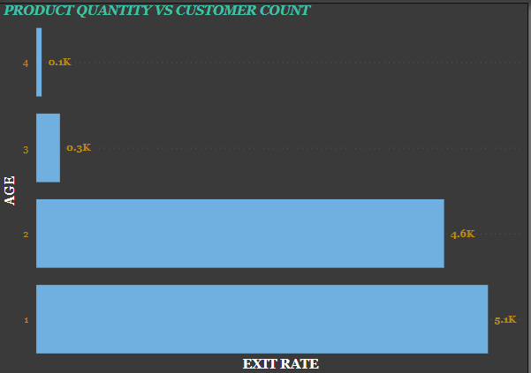
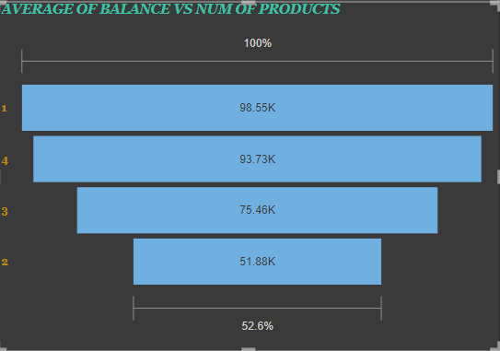
PRODUCT CATEGORY
The number of customers with all 4 products is very low. Hence we can use cross selling strategies to make customers use more number of products.
Around 51% of customers are having only a single product and 46% of them are having 2 products.
The average balance of customers is also high for customers who is having single product only which is closely followed by customers having 2 products.

Slide 9
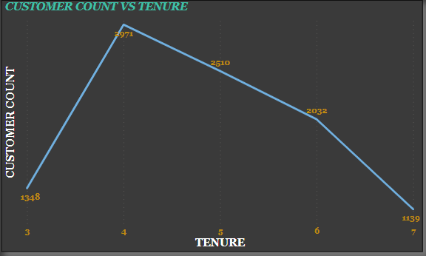
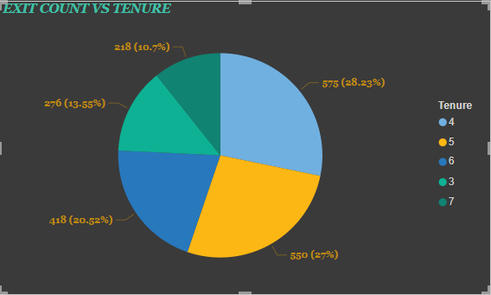
TENURE ANALYSIS
Mostly customer are retaining in the bank for a period of 4 years .
At the same time, the exit count is also high for customers who have been in the bank for 4 years.
This clearly states that the churn happens mostly after 4 years of joining the bank
The reason for churn is may be due to service dissatisfaction or product dissatisfaction.
Hence analysing customer feedbacks and introducing product variants that suits customer will help reduce the churn.

Slide 10
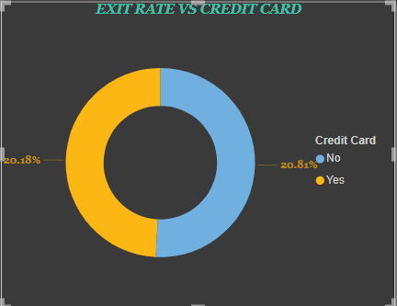
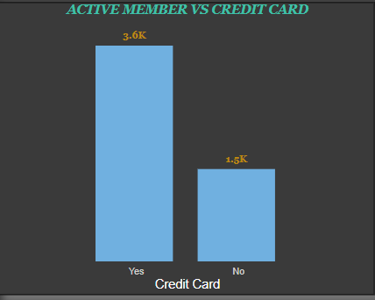
Credit card analysis
The exit rate of customers with or without credit card is almost equal. Hence the churn doesn’t happen due to credit card issues.
But the Active member count vs credit card chart states that out of total active members around 1.5k customers are not access to credit card
Since the customer is an Active member we can approach the customer for a credit card to reduce the churn rate as well as increase the cross selling strategies.

Slide 11
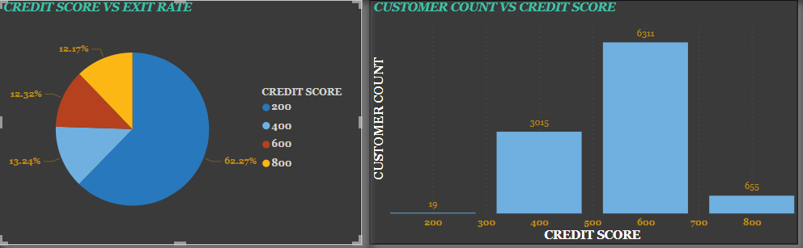
CREDIT SCORE ANALYSIS
The customers with low credit score segment is having high churn rate compared to customers having higher credit score. The actual customer base is having around 600-700 as their credit score.
Churn rate of customers with high credit score has to be analysed and steps have to be taken to reduce their churn rate.

Slide 12
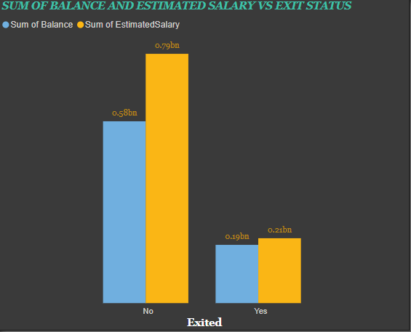
Balance, estimated salary vs exit rate analysis
The balance sum is always less than the sum of estimated salary of the customers.
The churned customers balance and estinmated salary is almost equal and hence the correlation is high among them
The churned customers can be offered new product offers to retain them
The balance maintained by the churned customers is around 0.19bn which in turn affects the profit of the bank.
Hence measures has to be taken to reduce the churn rate.

Slide 13
Suggestions
After analysing the dataset provided , it is clear several metrics has to be implemented to reduce the churn rate
1.Marketing Campaign-This is turn increase the Product Per Customer(PPC) count and also helps bank to increase the new customer base
2.Product Variant Introduction-New products has to be introduced according to the Geography ,Gender and Age Segment of the customer. This helps in attracting different segment customers and also reduces Churn.
3.Rewards and Offers-The rewards and offers can be introduced to High net worth customers and new customers in order to retain them and along with retention new offers and rewards will encourage customers to use more products.

Slide 14


